Slide 1

SJSU Spring 2020 EE122 lab section #5 lab 7
Using the gm/ID technique to design Common Source (CS) amplifiers
LTspice is required
TA check points required
Screenshot of your calculation upload (check point A-D)
Screenshot of your circuit design schematic, simulation and calculation (check point E and F)
Upload to canvas
No lab report
TA: Wen Zhi Qian
Email: wenzhi.qian@sjsu.edu

Slide 2

Check point A
Extract $V_{T}$ and $K_{N}$ (illustration link)
Download NMOS part 2n7000 from link
Open it and run simulation

Slide 3
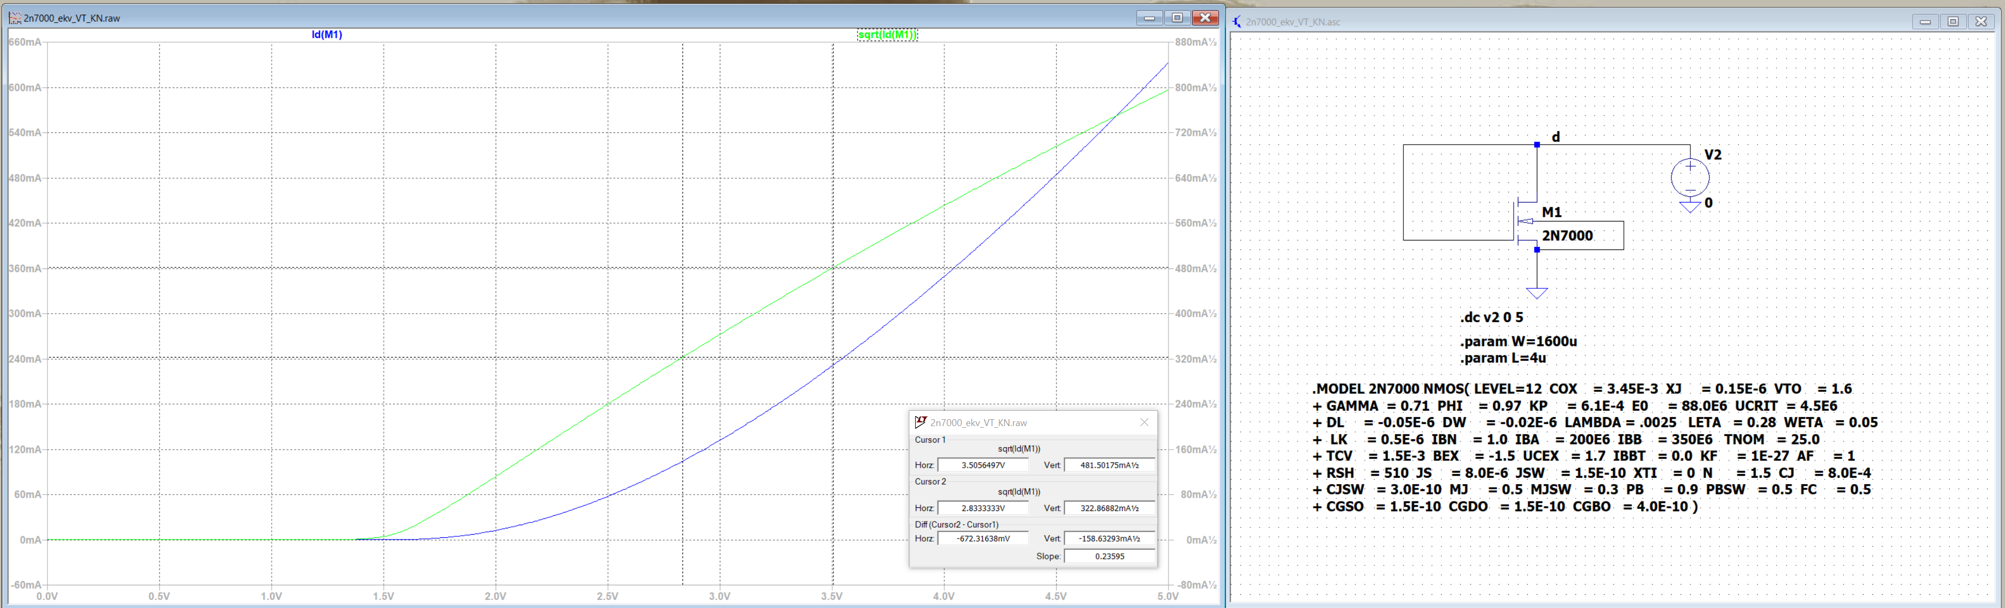
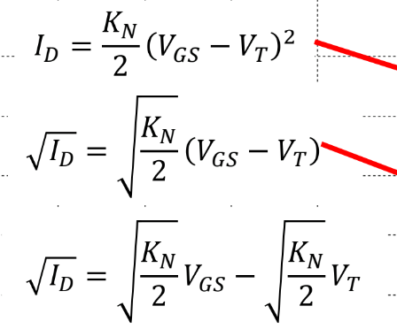
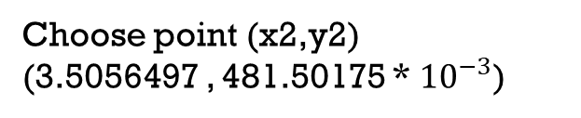

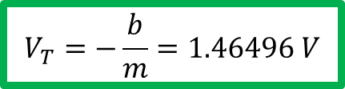




(x2,y2)
(x1,y1)
Sqrt(Id) Linearize as Y=mx+b
Slope m=0.23595=$\sqrt{\frac{K_{N}}{2}}$
$$K_{N}=0.111344805$$
$$V_{T}=−\frac{b}{m}=1.46496 V$$
$$b=y2 −mx2$$
Choose point (x2,y2)
(3.5056497 , 481.50175 * ${10}^{−3}$)
$$b=\text{481.50175 ∗ }{10}^{−3}−\text{0.23595}x\text{3.5056497}$$
$$b=−0.345656$$

Slide 4

Check point B
Extract $V_{A}$ (illustration link)
Download file from link (Note VG should be set to 2.1V)
Open it and run simulation

Slide 5
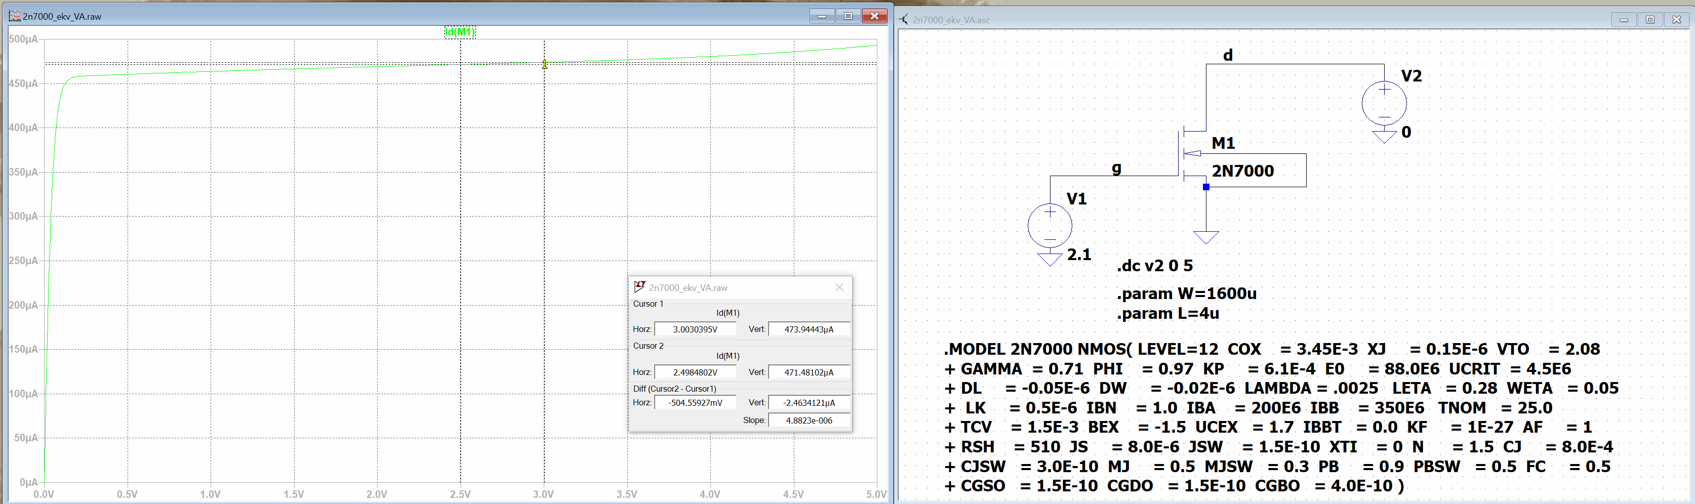


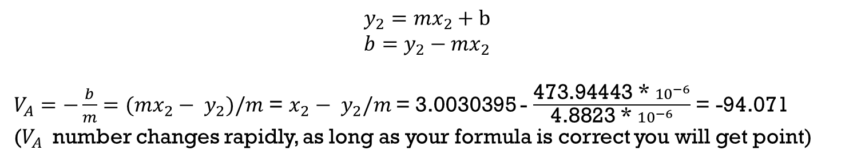
Your point should be select from this region. The NMOS is working at saturation region
.
(x2,y2)
(3.0030395 V, 473.94443 * ${10}^{−6}$ A)
XXX
Not select from this region
Slope m = 4.8823 * ${10}^{−6}$
$$y_{2}=mx_{2}+b$$
$$b=y_{2}−mx_{2}$$
$V_{A}=−\frac{b}{m}=(mx_{2}− y_{2})/m$ = $x_{2}− y_{2}/m$ = 3.0030395 - $\frac{\text{473.94443 ∗ }{10}^{−6}}{\text{4.8823 ∗ }{10}^{−6}}$ = -94.071
($V_{A}$ number changes rapidly, as long as your formula is correct you will get point)

Slide 6
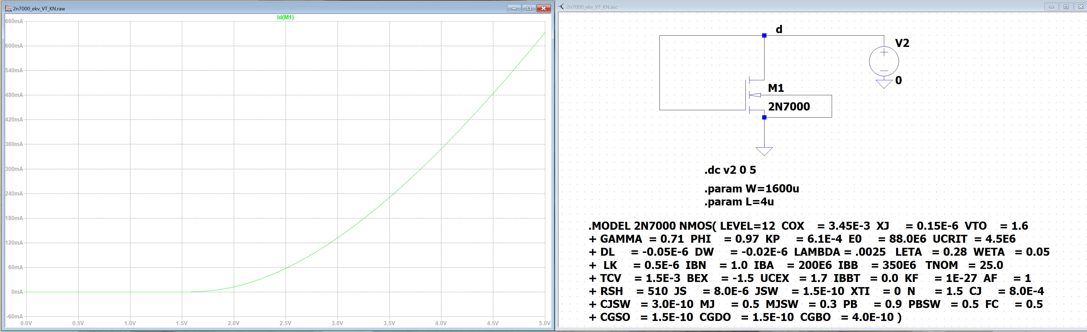
Check point C
Download NMOS part 2n7000 from link
Run simulation and plot Id(M1)
Figure 74: ID vs VDS for a 2N7000 Diode Connected MOSFET.
Figure 73: Diode connected MOSFET to extract gm/ID.

Slide 7
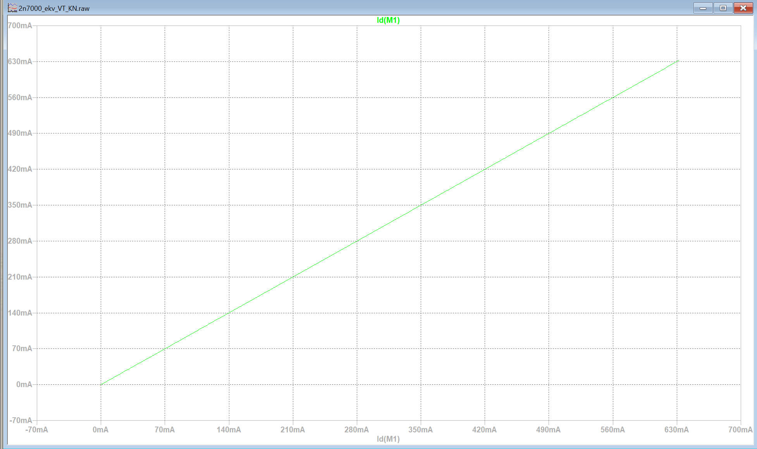
3. Right click on the x-axis and in the quantity plotted pop-up enter in Id(M1) to plot the current. Click OK. You should see Figure 75
Figure 75: Plotting current on the x-axis.

Slide 8
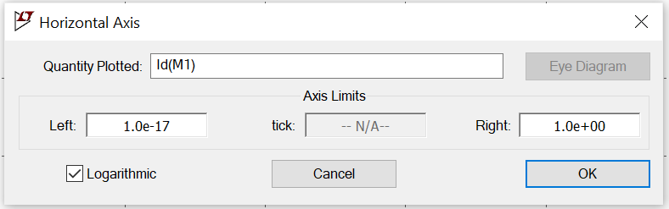
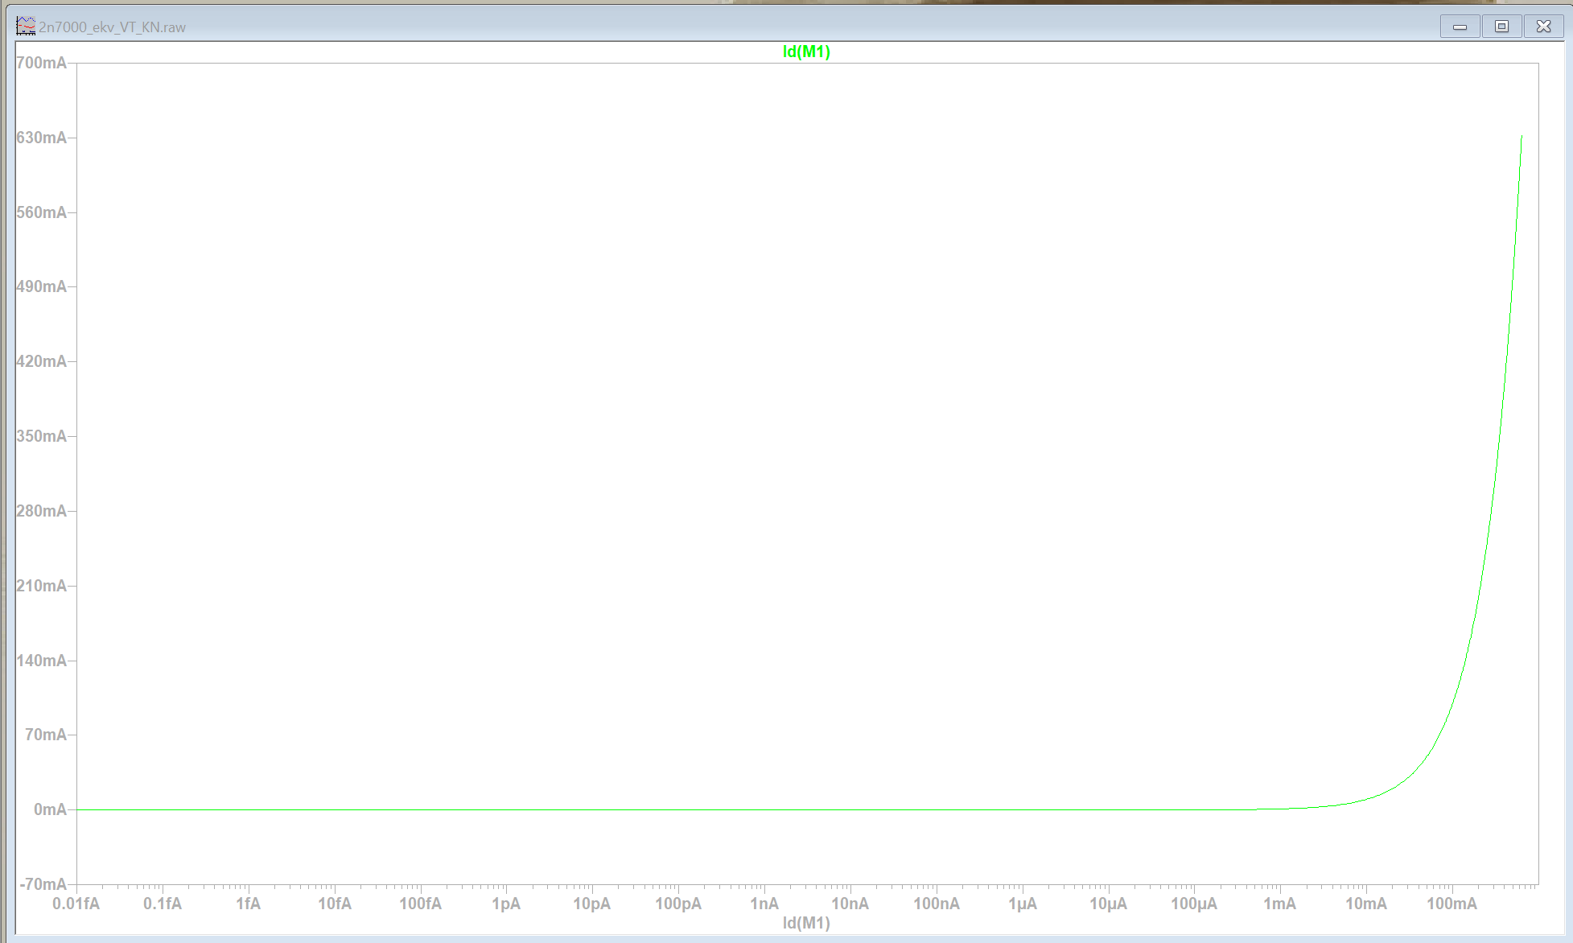
4. Right click again on the x-axis and this time click plot logarithmically in the pop up. You should see Figure 76
Figure 76: Changing the x-axis to plot logarithmically.

Slide 9
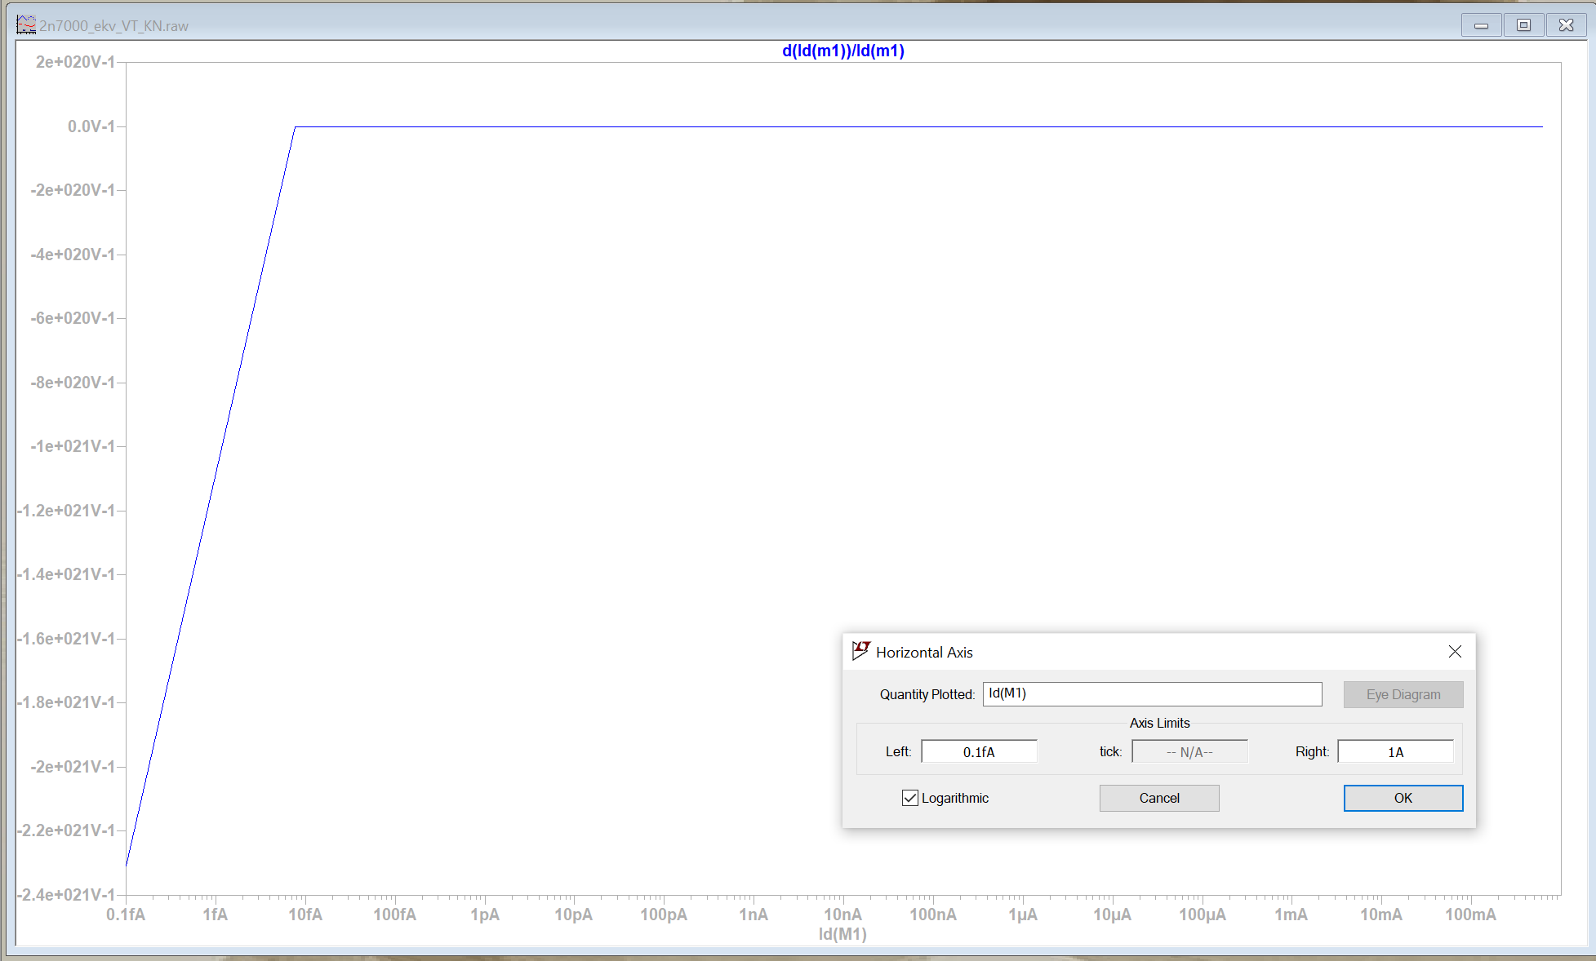
5. Go to plot settings and then add trace in the pop-up type: d(Id(m1))/Id(m1). d(Id(m1)) means take the derivative of the drain current of MOSFET M1. Delete the Id(M1) current plot. You should see Figure 77
x axis should still be logarithmic
Figure 77: Non-scaled gm/ID plot

Slide 10
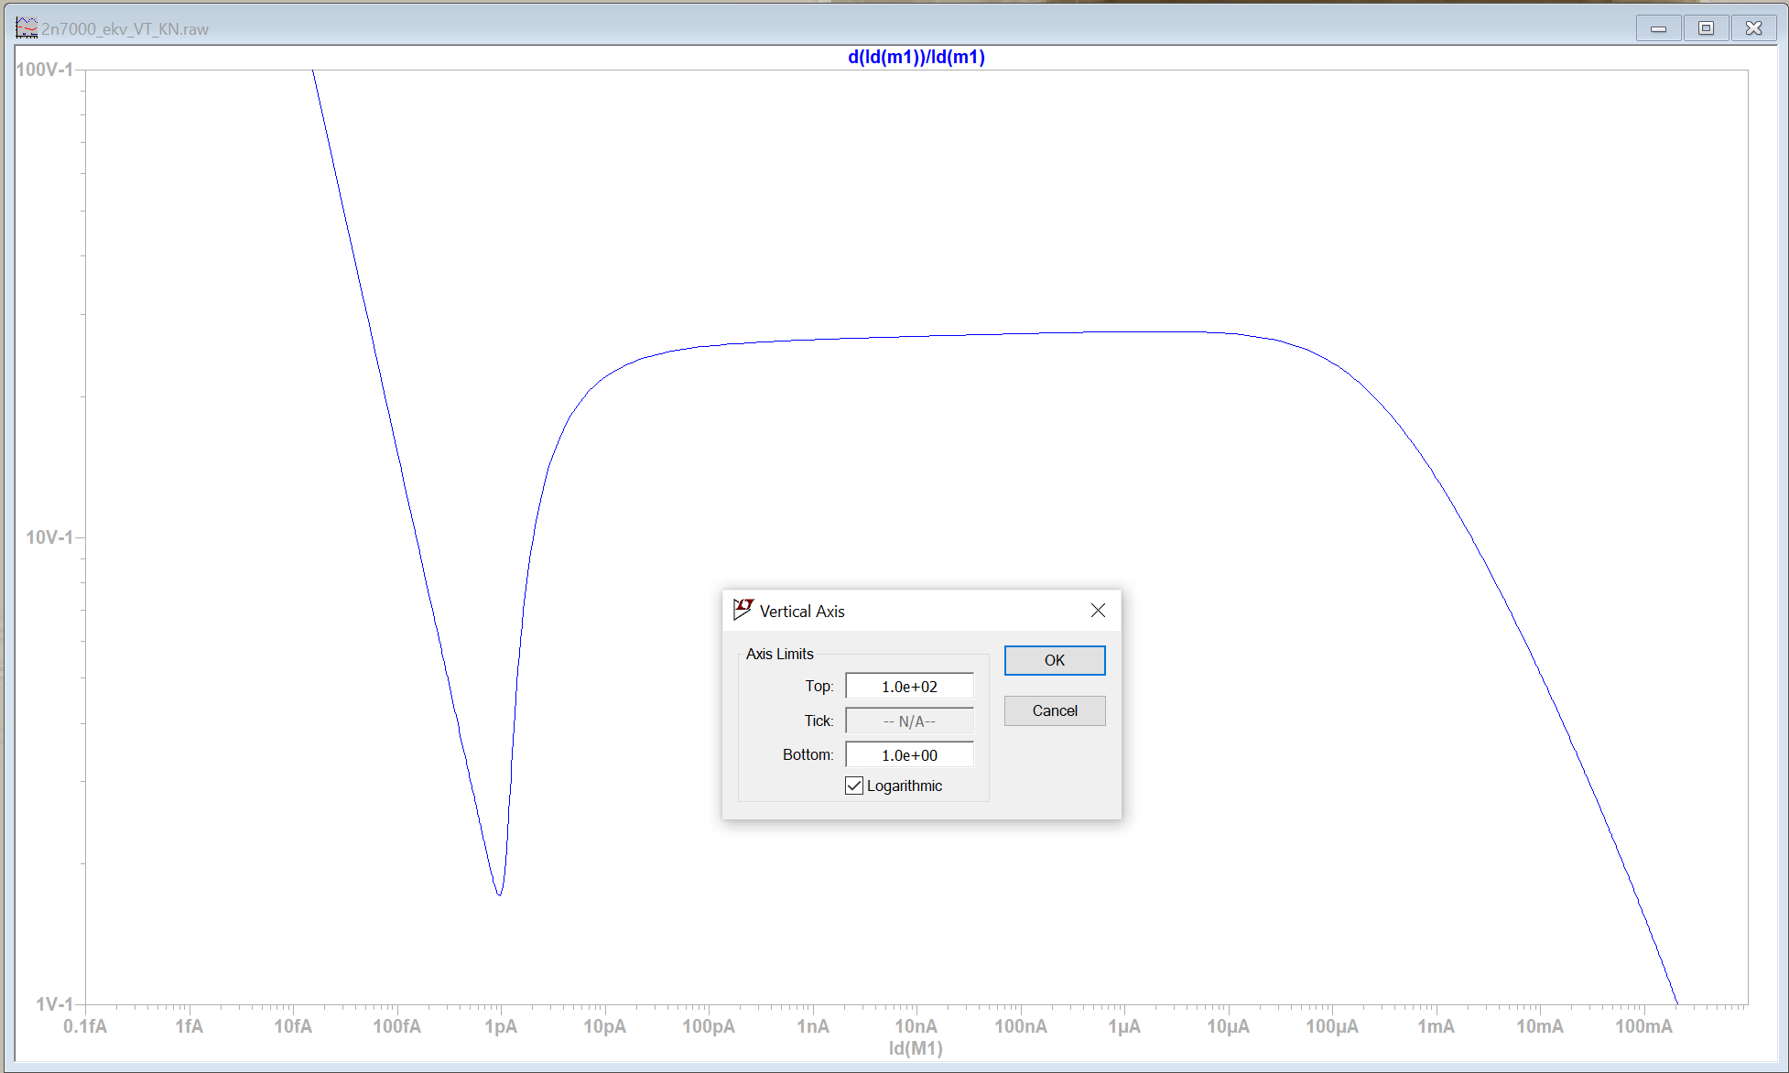
6. Go to plot settings and then add trace in the pop-up type: d(Id(m1))/Id(m1). d(Id(m1)) means take the derivative of the drain current of MOSFET M1. Delete the Id(M1) current plot. You should see Figure 77
y axis should still be logarithmic
Top: 100
Bottom: 1
Figure 78: Almost properly scaled gm/ID plot.

Slide 11
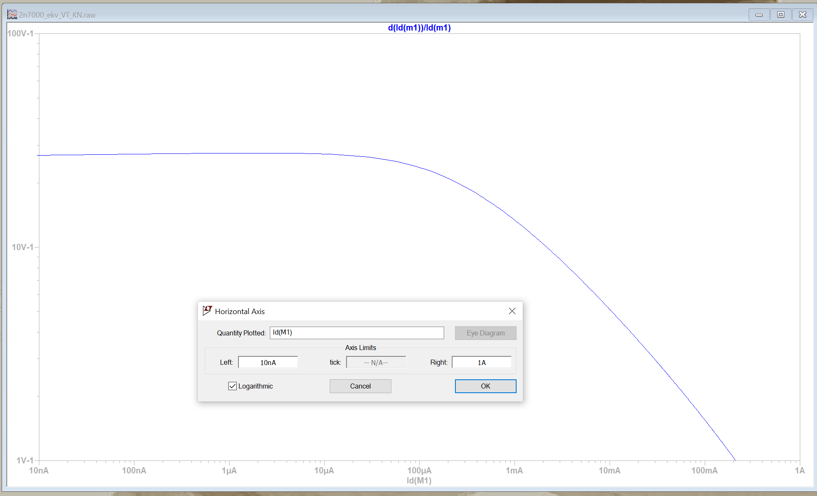
7. Left click on the x-axis again and enter in the left limit to be 10nA. You should see Figure 79.
x axis should still be logarithmic
Start from 10 nA
Figure 79: Properly scaled gm/ID plot.

Slide 12
Check point D

Slide 13
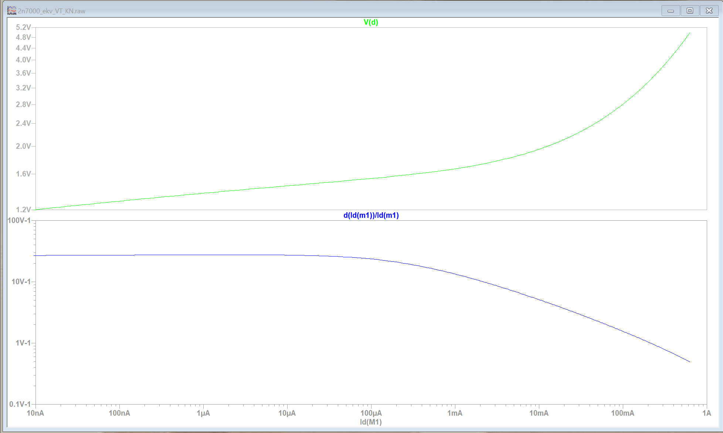
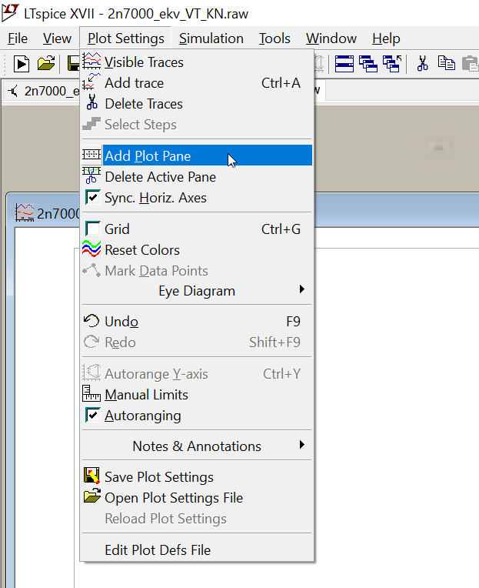
In order to bias a transistor, we need to know VGS. To get the VGS=VDS that caused a particular ID, go to plot setting and add plot plane. Plot VD, and scale it linearly as shown in Figure 80.
Figure 80: Gm/ID plot with VDS=VGS

Slide 14
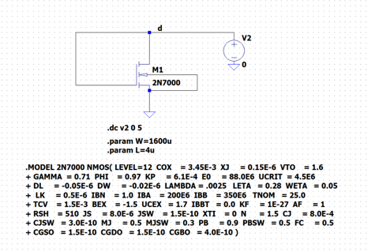
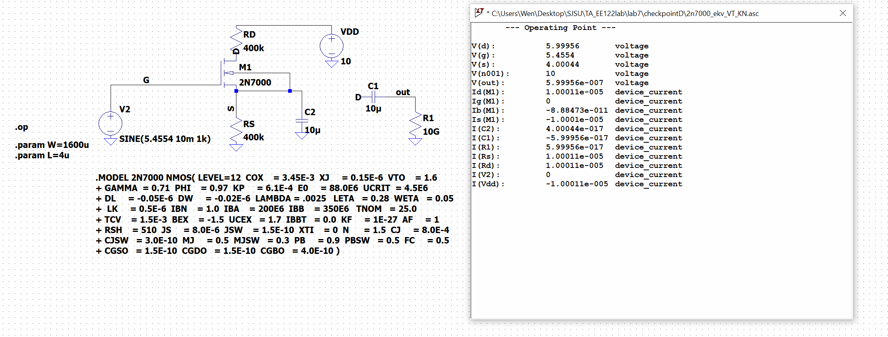
2. Modify from check point A circuit show below (left) to common source amplifier with degeneration
Simulate the DC Run operating point
Don’t forget to delete this
This results should match Table 2 in your lab manual

Slide 15
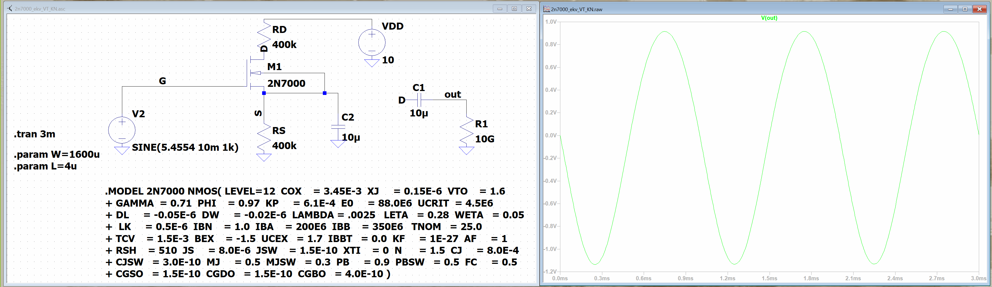
3. Run a transient simulation for 3ms and plot V(out). You should see figure 82.
Figure 82: Transient simulation of CS amplifier.

Slide 16
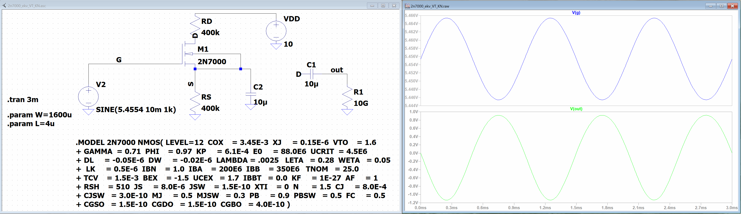

Slide 17
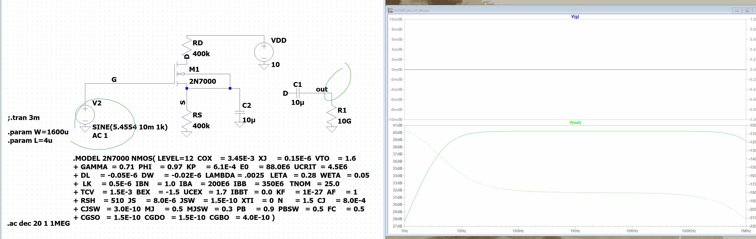
Gain=20log(Vout/Vin)

Slide 18
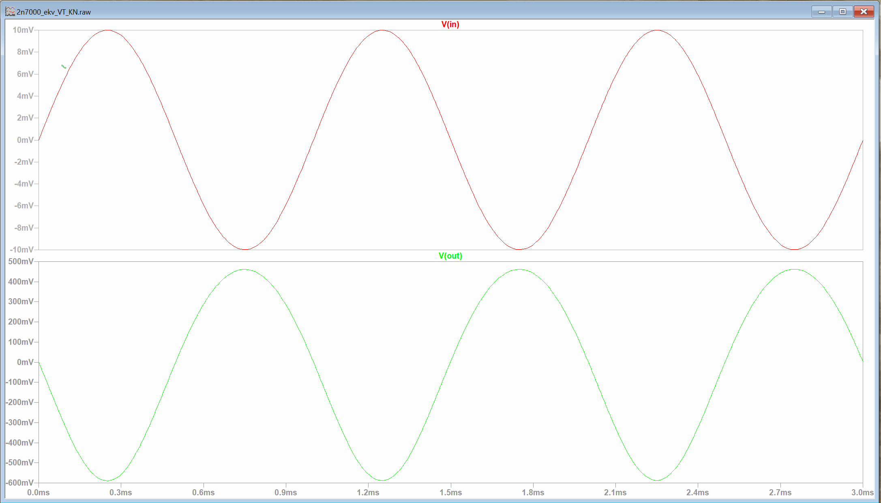
Check point E
Using the Gm/ID method design and verify in LTspice a CS amplifier with a gain of -50. Select R1 and R2 according to this link
10mV
|Vout/Vin|
= |461mV/10mV|
= |46.1|
461mV
Close enough to 50

Slide 19
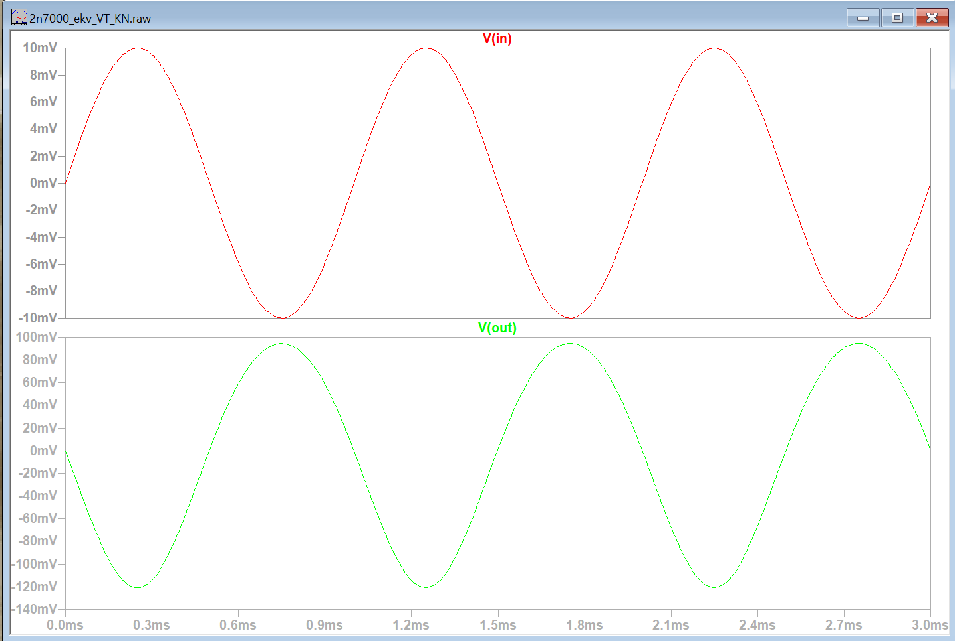
Check point F
Using the Gm/ID method design and verify in LT spice a CS amplifier with a gain of -10 that has a non-zero source resistance in the AC model. Select R1 and R2 according to link
9.97mV
|Vout/Vin |
= |95mV/9.97mV|
= |9.5|
95mV
Close enough to 10

